Slide 1
Software Project Lab-1
Name : Junaid Mansur Ifti
Roll:1027
Supervised By
Dr. Naushin Nower
Associate Professor
IIT,DU

Slide 2
Project Name: Pseudo 3D Racing Game
Language Used:C++
Additional Tools Used:
SFML(Simple and Fast Multimedia Library)

Slide 3
Purpose of creating Racing game
New Challenge and a New Area to widen coding knowledge
Interesting and Fun at the same time
Graphical visualization of written codes
Scope of implementation of Car Physics and Mathematics.

Slide 4
Pseudo 3D Perspective
At its most basic, without getting into vectors and matrices, 3D projection uses a
law of similar triangles.
If we were to label:
h = camera height
d = distance from camera to screen
z = distance from camera to car
y = screen y coordinate
Then we could use the law of similar triangles to calculate
y = h*d/z
as shown in the diagram below:

Slide 5
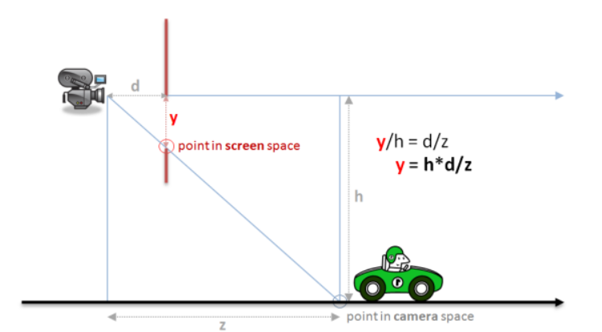

Slide 6
Coordinate Systems This sounds nice and simple in diagram form, but once you start coding its easy to get a little confused because we have been a bit loose in naming our variables and its not clear which represent 3d world coordinates and which represent 2d screen coordinates. We’ve also assumed that the camera is at the origin of our world when in reality it will be following our car. More formally we should be: 1.Translating from world coordinates to camera coordinates 2.projecting camera coordinates onto a normalized projection plane 3.scaling the projected coordinates to physical screen (in our case canvas) coordinates

Slide 7
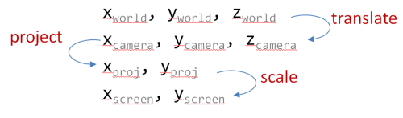

Slide 8
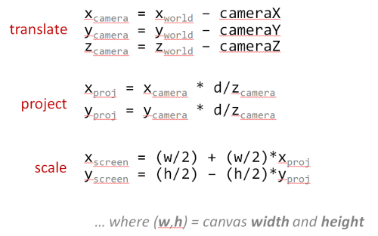

Slide 9
SFML
Simple and Fast Multimedia Library (SFML) is a cross-platform software development library designed to provide a simple application programming interface (API) to various multimedia components in computers. It is written in C++ with bindings available for many other languages.

Slide 10
Why Using SFML
SFML provides a simple interface to ease the development of games and Multimedia
Applications .It has some simple yet important features which is why it has been chosen to use:
1.SFML is Multi-Platform.
2.SFML is Multi-Language
3. It is composed of five modules: system, window, graphics, audio and network.

Slide 11
New Learnings:
1.Practical Implemention of a New External Library.
2.Intregating SFML Library with Microsoft Visual C++ 2017 and Configuring a SFML Project.
3.Understanding and Learning new API Documentations.
4.Use and implementation of Mathematical logics to Create track and movement of Vehicle.
5.Use of Sprites of Textures and Implementing graphically using co-ordinates.

Slide 12
Steps of Project
To complete this project successfully,The process has been divided into Following parts-
Learning the new API Documentations of SFML and Understanding classes and modules.
Opening and Managing SFML Window, Drawing 2D Sprites and Textures,Texts and Fonts,Shapes. Positioning,Rotation and Switching Entities,Controlling 2D Camera and views.

Slide 13
3.Learn to Handle external User inputs ( Keyboard or peripherals) and Adding Movement to the Entity.Making the game time limited by adding clock.
4.Creating Obstacle on the track and Enriching the Environment of the Surrounding of the Racing Track.
5.Handling time and Showing the time a racetrack is finished racing.

Slide 14
Coding Works

Slide 15
Scaling from World to Screen Co-Ordinate:
1.translating from world coordinates to camera coordinates
2.projecting camera coordinates onto a normalized projection plane
3.scaling the projected coordinates to physical screen (in our case canvas) coordinates

Slide 17
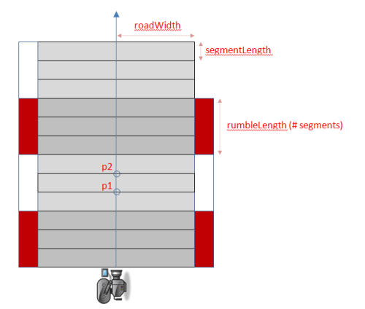
Raster Road Making

Slide 18
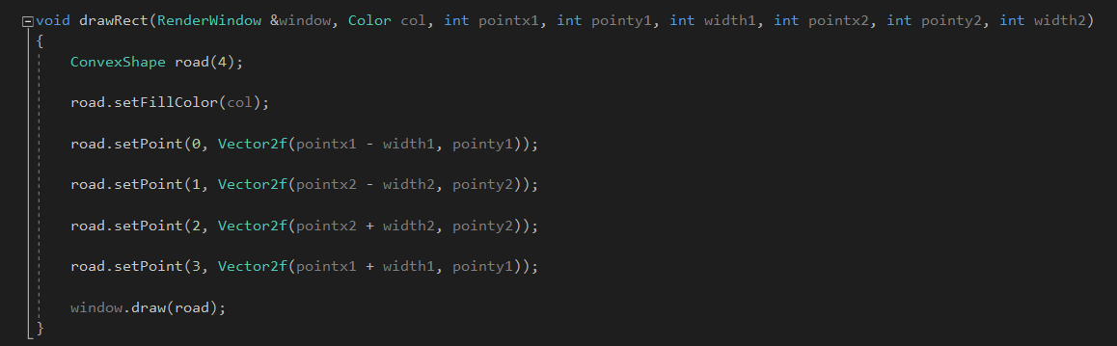
The Coding Implementation:
SFML ConvexShape class is used here to implement the Road.

Slide 19
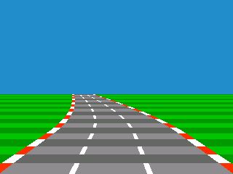

Slide 20
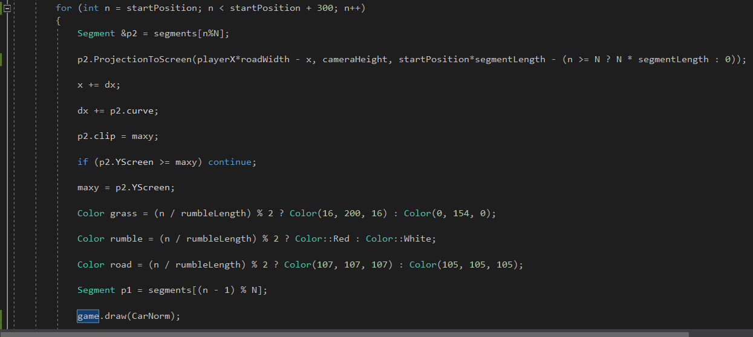
The Green color is Grass,The Red-white color things are rumble and the other half in grey color is the main road.Half of the height of the screen makes a Sky effect.
The different parts of road is rendered in this code Portion

Slide 21
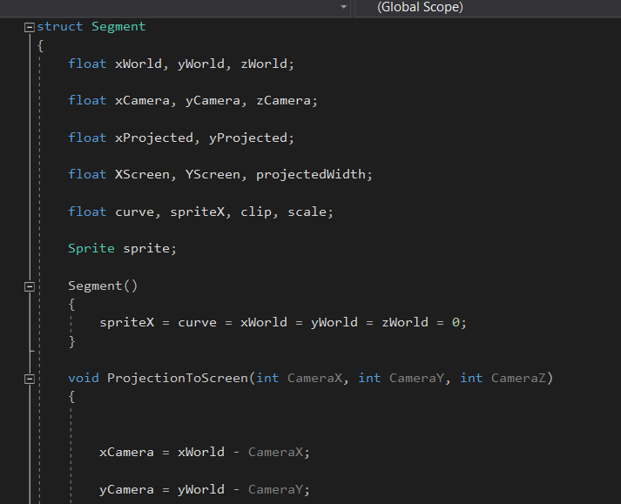
3D to 2D

Slide 22
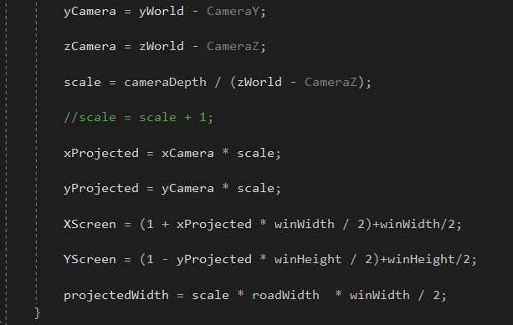
3D to 2D

Slide 23
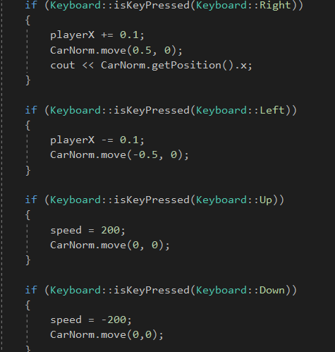
User input Handling

Slide 24
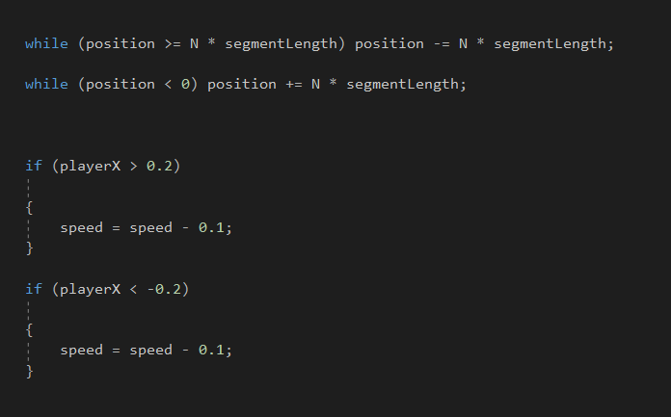
Road Loop

Slide 25
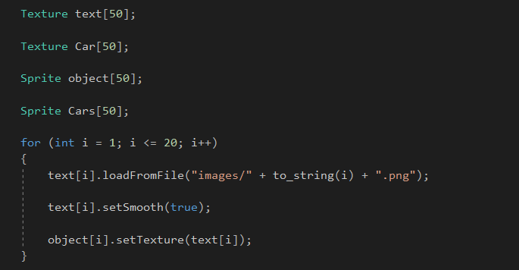
Sprite and Texture Rendering

Slide 26
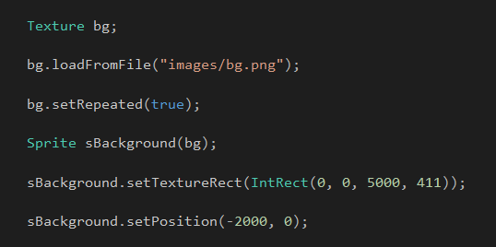

Slide 27
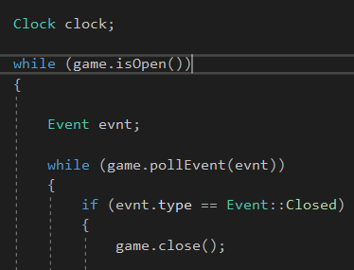
Time Maintain ace and Collision Detection

Slide 28
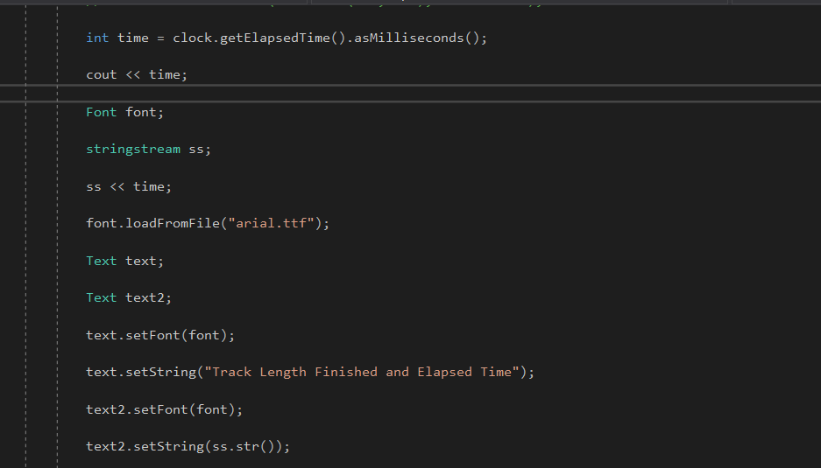
Clock time showing

Slide 29
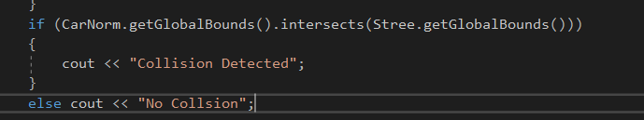
Collison Detection

Slide 30
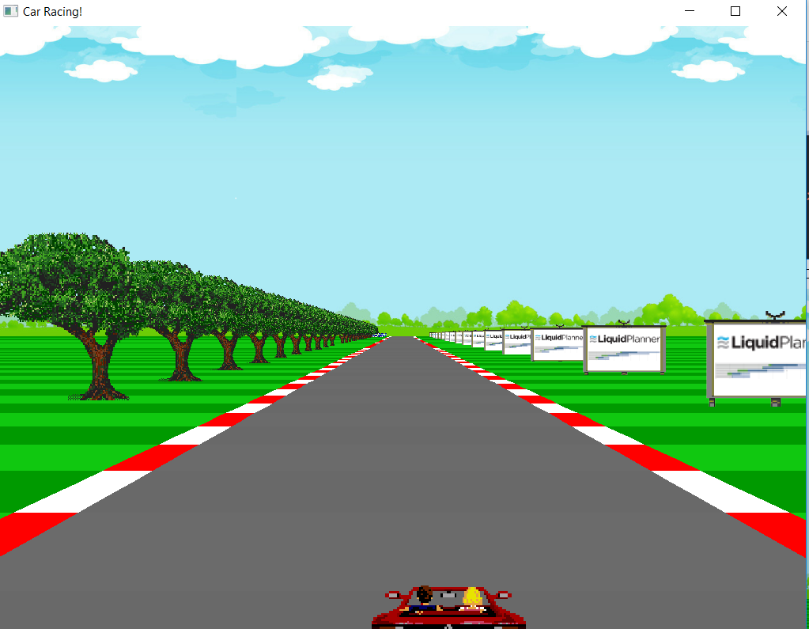
Game Environment

Slide 31
Thankyou

